Slide 1
Object tracking
배지운 이영수

Slide 2
Overall
Object tracking using mean shift process
Language: C++
Library: OpenCV

Slide 3
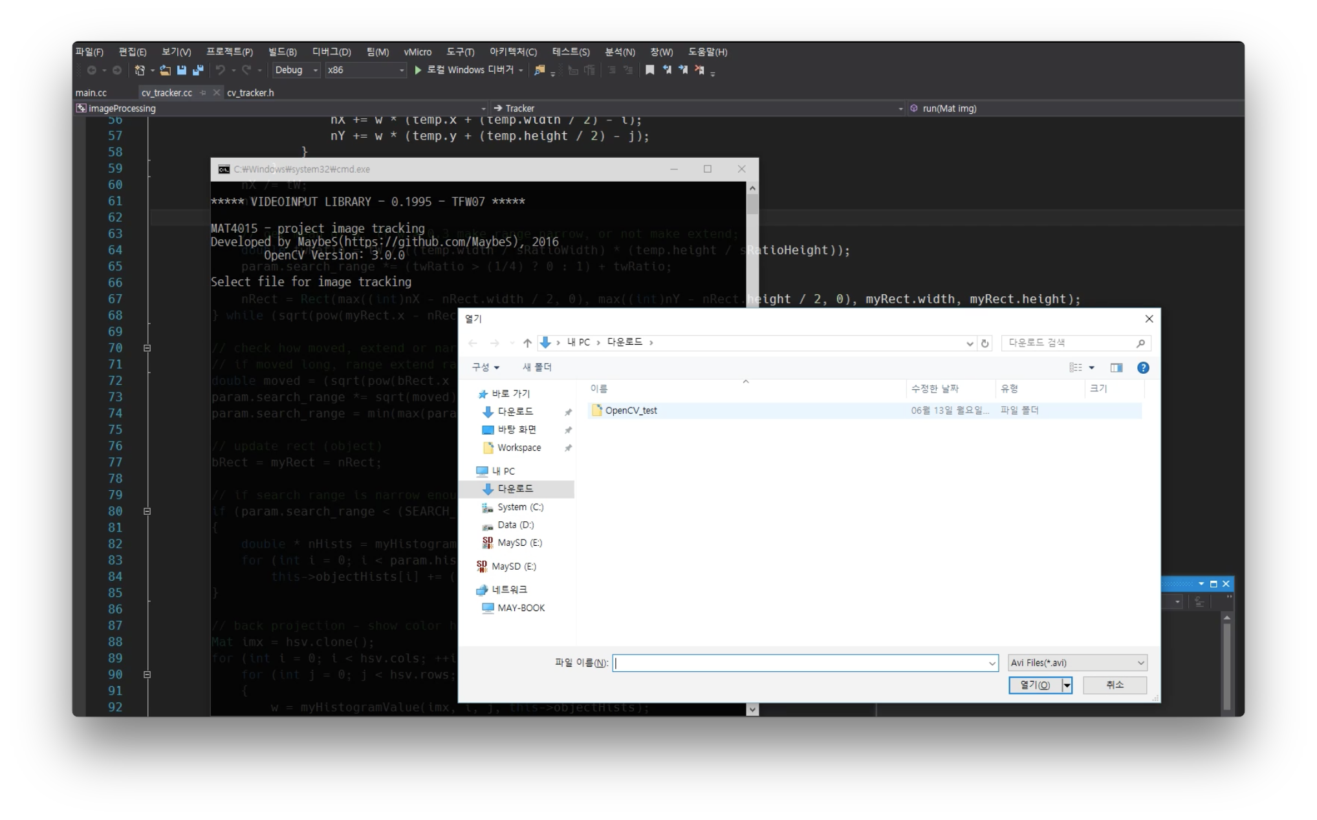
1. Set target object
Load movie using VideoCapture class

Slide 4
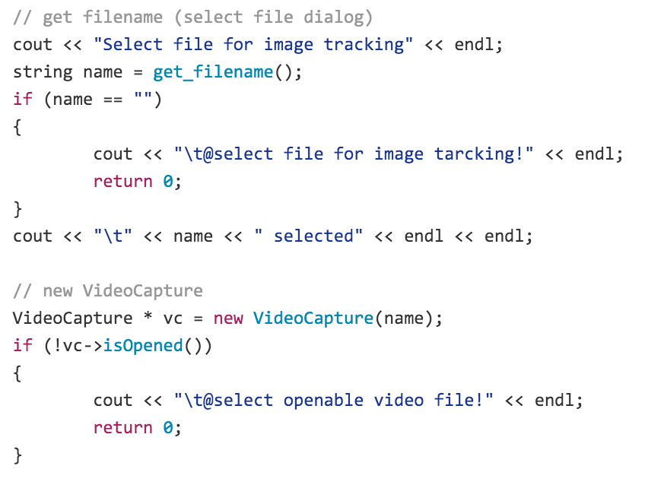
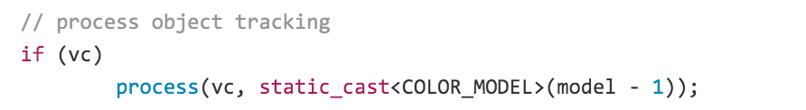
1. Set target object
Load movie using VideoCapture class

Slide 5
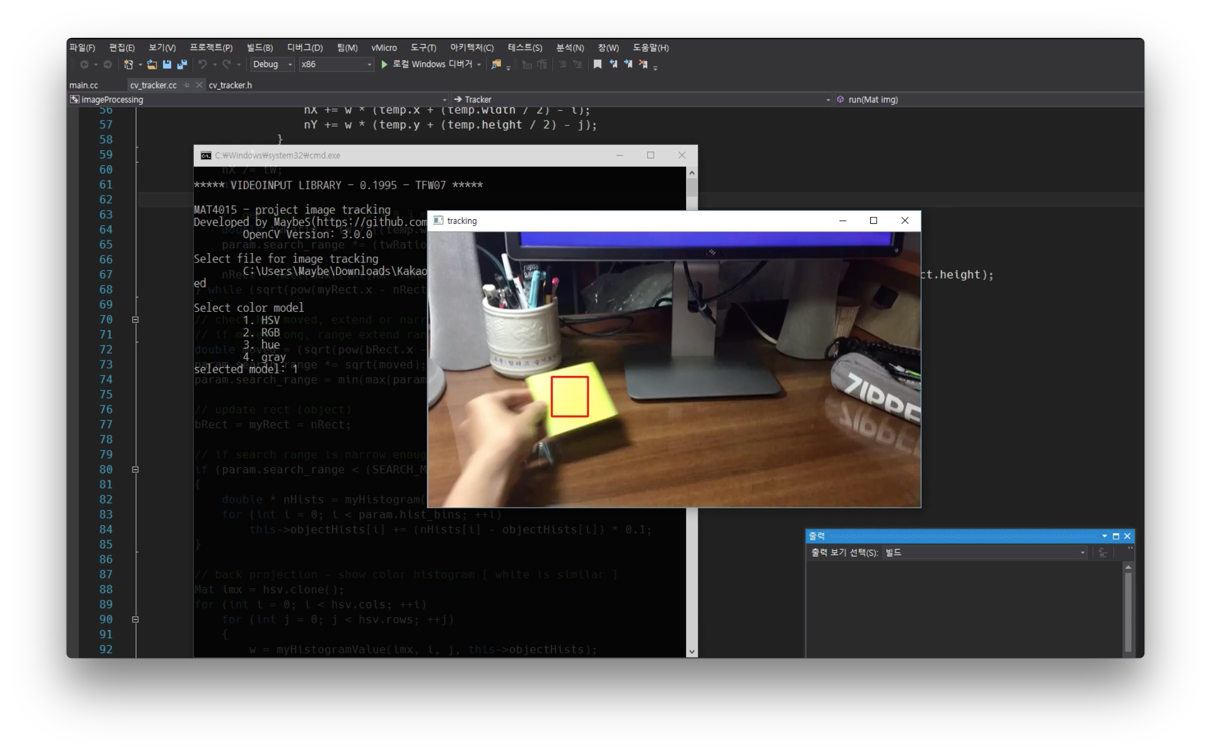
1. Set target object
Rectangular box setting by mouse drag

Slide 6
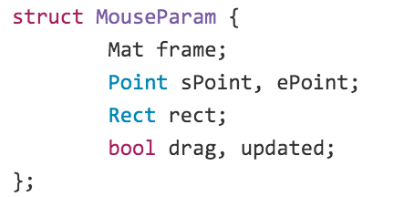
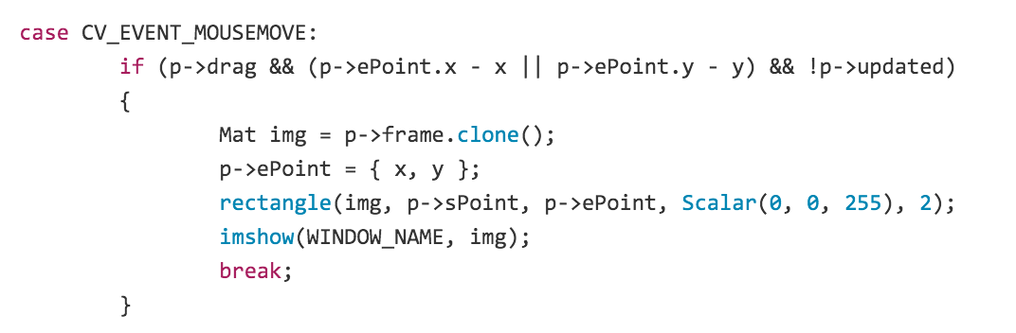
1. Set target object
Rectangular box setting by mouse drag

Slide 7
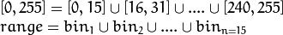
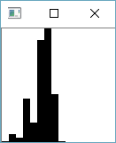
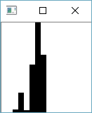
1. Set target object
Modeling color histogram of object

Slide 8
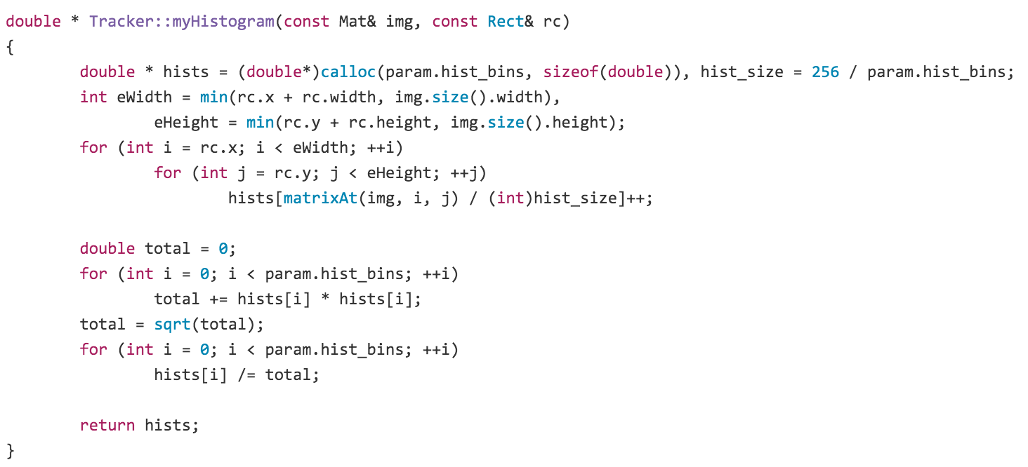
1. Set target object
Modeling color histogram of object

Slide 9
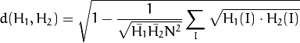
2. Back projection
Calculate histogram similarity
Modification version of Bhattacharyya distance

Slide 10
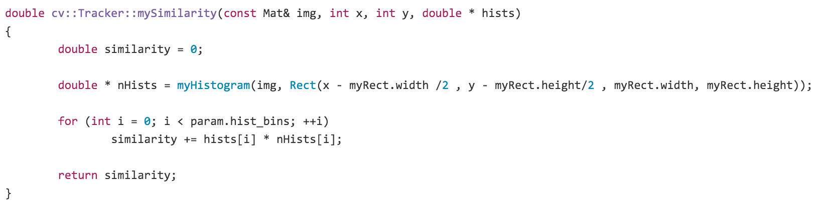
2. Back projection
Calculate histogram similarity

Slide 11
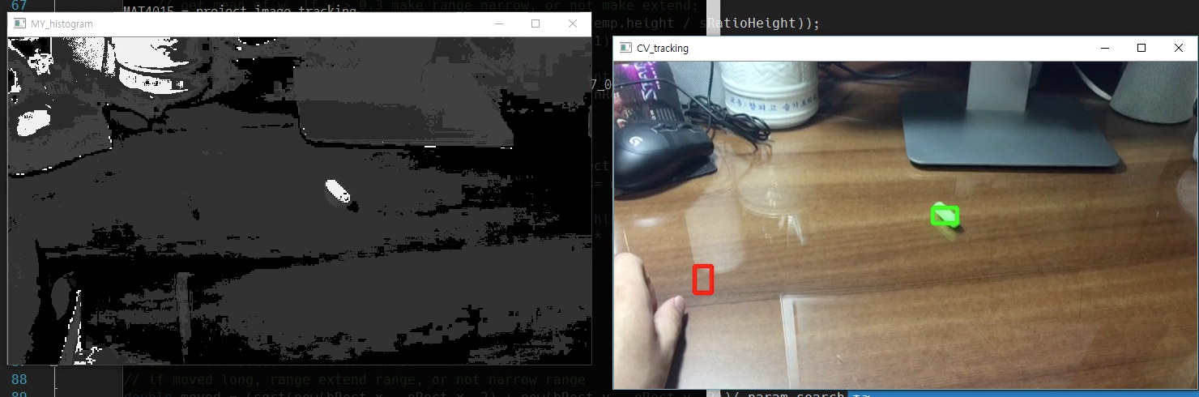
2. Back projection
Back projection

Slide 12
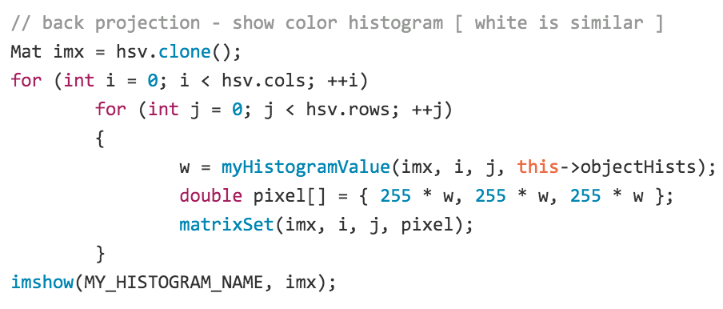
2. Back projection
Back projection

Slide 13
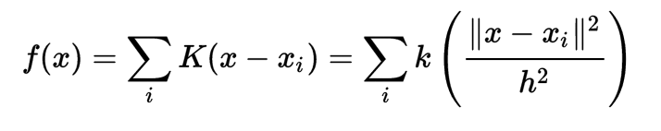
3. Mean shift process
Mean shift clustering of pixels with back projected weights

Slide 14

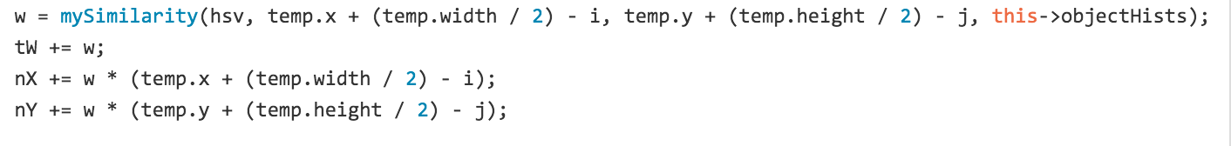
3. Mean shift process
Mean shift clustering of pixels with back projected weights
…
…

Slide 15
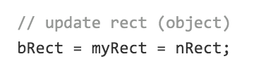
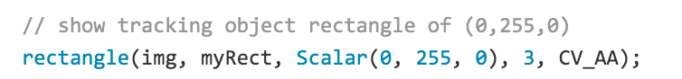
4. Updating
Update object after tracking

Slide 16
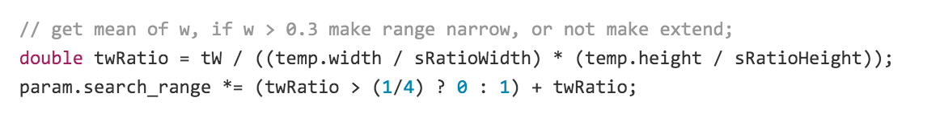
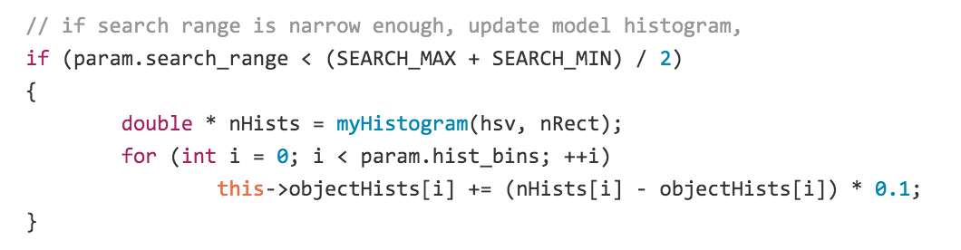
5. Other functions
탐색영역 동적 변경
타겟 히스토그램 동적 변경

Slide 17
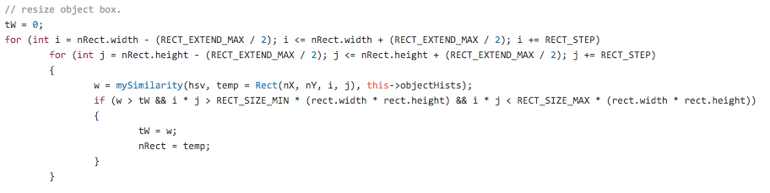
5. Other functions
박스 사이즈 변경

Slide 18
References
OpenCV document
http://docs.opencv.org/2.4/doc/tutorials/imgproc/histograms/back_projection/back_projection.html
한양대학교 확률및통계 강의자료
Image processing
Mean shift
OpenCV basic

